Slide 1
A Design Process
Introduction
© 2011 Project Lead The Way, Inc.

Slide 2
What Is Design?
The word “design” is often used as a generic term that refers to anything that was made by a conscious human effort.
Design is also a process that is used to systematically solve problems.
Notes:
Talk to students about how they use design every day. The process for getting ready for school is one example.

Slide 3
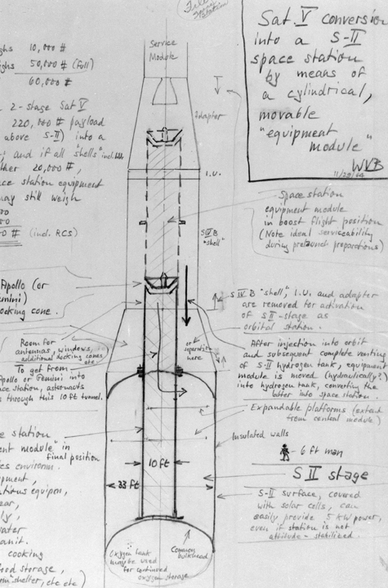
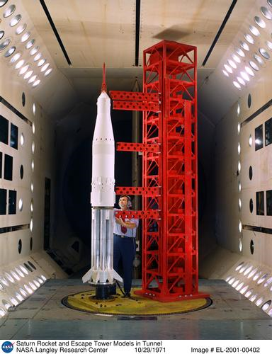
What Is a Design Process?
A design process is a systematic problem-solving strategy, with criteria and constraints, used to develop many possible solutions to solve or satisfy human needs or wants and to narrow down the possible solutions to one final choice.
– ITEA Standards for Technological Literacy
Images courtesy of NASA
Notes:
The first image is a von Braun sketch from 1964.
The second is an engineer in 1971 working with a Saturn V model.

Slide 4
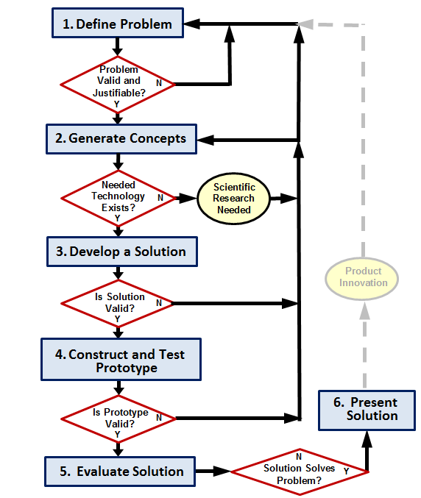
Design Process
Define the Problem
Generate Concepts
Develop a Solution
Construct and Test a Prototype
Evaluate the Solution
Present the Solution
This design process was developed based on the University of Maryland - College Park - IRB Research Project

Slide 5
Define the Problem
Identify a problem
Validate the problem
Who says it is a problem?
Needs and wants
Prior solutions
Justify the problem
Is the problem worth solving?
Create design requirements (specifications)
Criteria and constraints
Design Brief

Slide 6
Define the Problem
Design Brief
A written plan that identifies a problem to be solved, its criteria, and its constraints.
Used to encourage thinking of all aspects of a problem before attempting a solution.

Slide 7
Define the Problem
Identify a problem
Validate the problem
Who says it is a problem?
Needs and wants
Prior solutions
Justify the problem
Is the problem worth solving?
Create design requirements (specifications)
Criteria and constraints
Design Brief
In some cases, if the problem is not valid or justifiable, the designer must define a new problem.

Slide 8
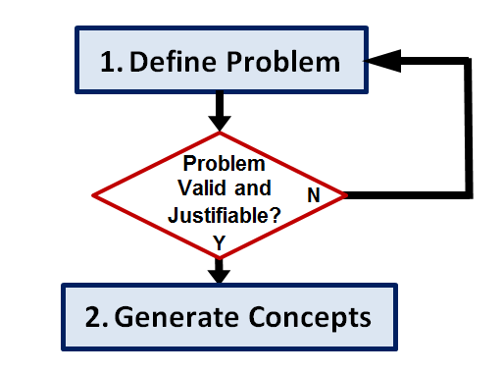
Generate Concepts
Research
Brainstorm possible solutions
Consider additional design goals
Apply STEM principles
Select an approach
Decision Matrix
Notes:
When generating concepts the designer should research past solutions and brainstorm new ideas. During the brainstorming process, additional design goals that will enhance the design may become apparent. As in all steps of the Design Process, the designer should apply STEM (science, technology, engineering, and mathematics) principles.
Once you have generated multiple possible solutions, narrow your efforts to one (or a few) solution paths. One method of selecting an approach is the use of a Decision Matrix.

Slide 9
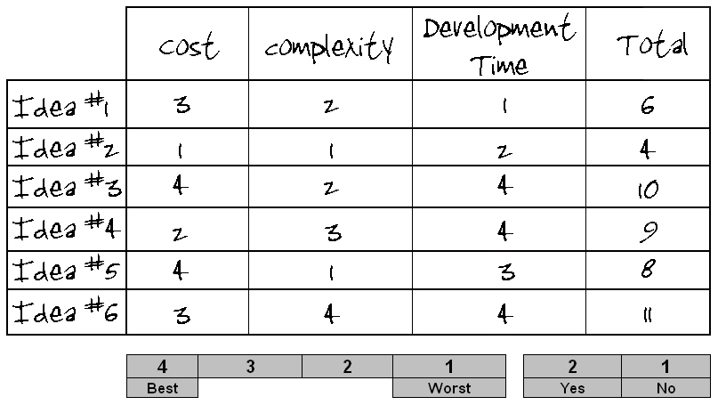
Generate Concepts
Decision Matrix
A tool used to compare design solutions against one another, using specific criteria.

Slide 10
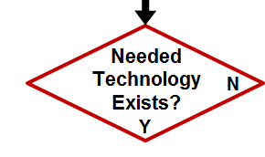
Generate Concepts
Research
Brainstorm possible solutions
Consider additional design goals
Apply STEM principles
Select an approach
Decision Matrix
If the technology necessary to develop the solution does not exist, scientific research may be necessary to pursue a solution.
Notes:
If technology does not exist that would allow development of the solution path selected, you believe that alternate concepts can be developed with available technology, you may choose another concept that you have already generated or continue to brainstorm in step 2. However, if it appears that the problem may not be solvable at all with existing technology, you may return to step 1 to redefine the problem. One option is to define a problem that will lead to development of the technology necessary for a solution to the original problem.
Note that, in general, a flow chart will not include a flow path that diverges without a decision box, as is the case here when returning to an earlier step. When returning to an earlier step, the designer must decide the most appropriate step to which to return.

Slide 11
Develop a Solution
Create detailed design solution
Justify the solution path
Technical Drawings

Slide 12
Develop a Solution
Technical Drawings
Drawings that provide technical information necessary to produce a product.
material, size, shape
assembly, if necessary

Slide 13
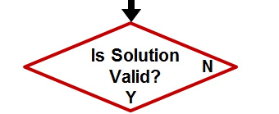
Develop a Solution
Select an approach
Decision Matrix
Create detailed design solution
Technical Drawings
Justify the solution path
If a solution is found to be invalid or cannot be justified, the designer must return to a previous step in the design process.

Slide 14
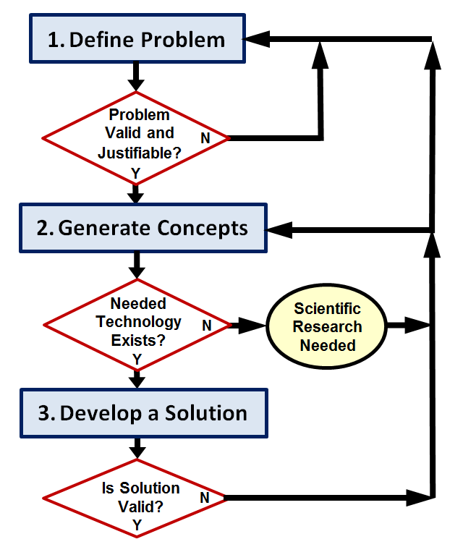
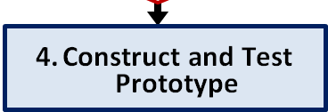
Construct and Test a Prototype
Construct a testable prototype
Plan prototype testing
Performance
Usability
Durability
Test prototype
collect test data
analyze test data
Test Report

Slide 15
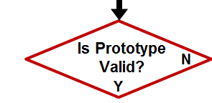
Construct and Test a Prototype
Construct a testable prototype
Plan prototype testing
Performance
Usability
Durability
Test prototype
collect test data
analyze test data
Test Report
If a testable prototype cannot be built or test data analysis indicates a flawed design, the designer must return to a previous step of the design process.

Slide 16
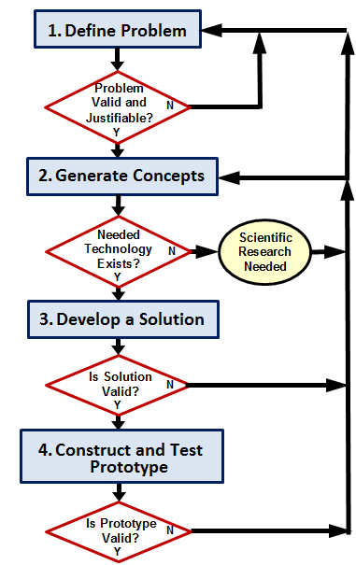
Evaluate the Solution
Evaluate solution effectiveness
Reflect on design
Recommend improvements
Optimize/Redesign the solution
[Return to prior design process steps, if necessary]
Revise design documents
Project Recommendations

Slide 17
Evaluate the Solution
Evaluate solution effectiveness
Reflect on design
Recommend improvements
Optimize/Redesign the solution
[Return to prior design process steps, if necessary]
Revise design documents
Project Recommendations

Slide 18
Evaluate the Solution
Does the solution solve the problem?
If not, the designer must return to a previous step of the design process.

Slide 19
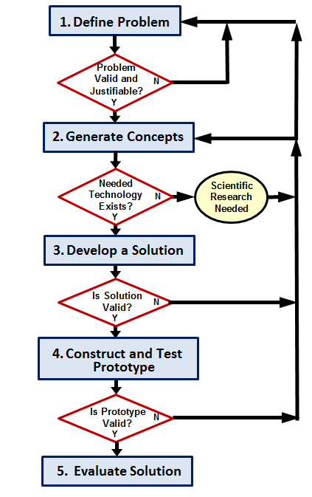
Present the Solution
Document the project
Project Portfolio
Communicate the project
Formal Presentation

Slide 20
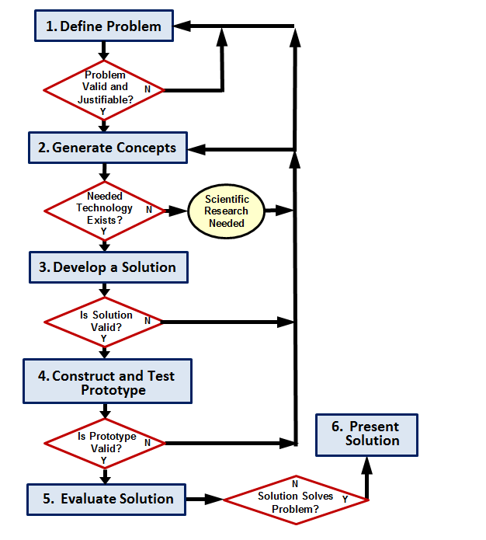
Design Process
Iterative
Notes:
Although we have presented a design process in a somewhat linear fashion, the path from identifying a problem to presenting a solution is rarely straightforward. Designers must evaluate, reflect, redefine, and redesign throughout the process. It is common to repeat steps of the design process several times before an optimal solution is found.

Slide 21
A Design Process
Product improvement or redesign will require the designer to repeat the design process.
Product Innovation

Slide 22
Image Resources
National Aeronautics and Space Administration (NASA). (n.d.). NASA image exchange. Retrieved from http://nix.nasa.gov/.

