Slide 1
Decision Making Matrix
Forging new generations of engineers
Introduction
© 2011 Project Lead The Way, Inc.

Slide 2
Decision Making Matrix
Taking a Close Look at Preliminary Ideas

Slide 3
Develop a Decision Matrix
A decision matrix is used to compare design solutions against one another, using specific criteria that are often based on project requirements.

Slide 4
Identifying Ideas or Alternatives
What material would be best for creating models of puzzle pieces?

Slide 5
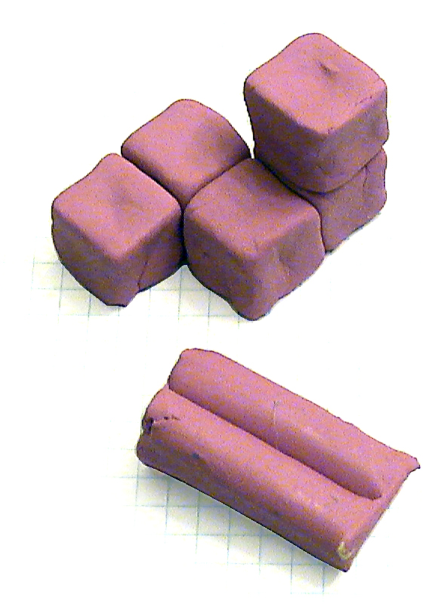
Idea #1
Modeling Clay
Reusable
Readily available
Requires forming
Sticky
Imprecise geometry

Slide 6
Idea #2
Caramel Cubes
Cheap
Readily available
Pre-shaped
Sticky
Imprecise geometry

Slide 7
Idea #3
Dice
Expensive
Reusable
Require 2-sided tape
Moderately stable
Precise geometry

Slide 8
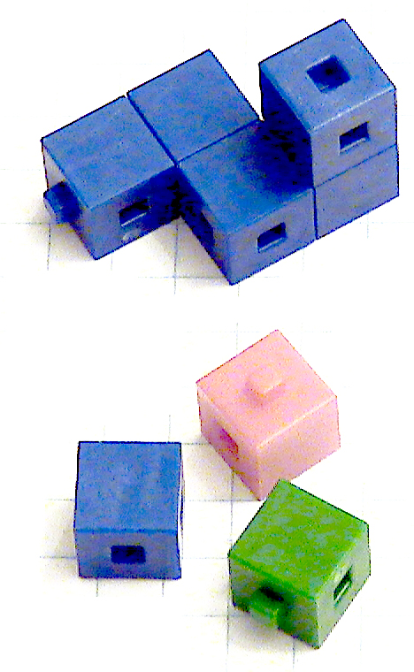
Idea #4
Centimeter Cubes
Cheap
Reusable
Interlocking
Protrusions
Precise geometry

Slide 9
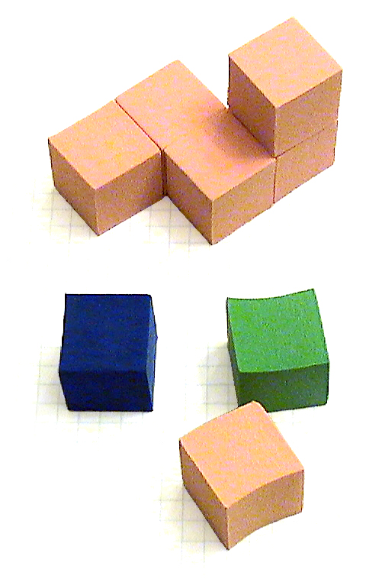
Idea #5
Foam Blocks
Expensive
Reusable
Require 2-sided tape
Fall apart easily
Imprecise geometry

Slide 10
Idea #6
Sugar Cubes
Cheap
Readily available
Require glue
Have messy granules
Fairly uniform geometry

Slide 11
Identifying Criteria
Cost
Reusability
Geometry
Connections
Cleanliness
Resilience
Testability

Slide 12
Other Types of Criteria
Function
Product life span
Development time
Size
Material costs
Development costs
Manufacturing costs
Company standards
Manufacturing capabilities
Safety

Slide 13
Develop a Decision Matrix
A grading scale must be developed to assign values for each criteria category.
Question Scale
Rank Scale

Slide 14
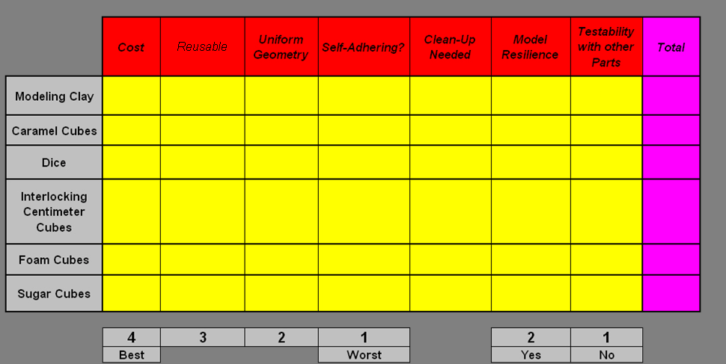
Ranking The Alternatives
2
2
1
2
1
1
1
10
3
1
2
2
2
1
1
12
1
2
4
1
3
2
4
17
4
2
4
2
4
4
2
22
1
2
3
1
3
2
2
14
4
1
3
1
2
3
3
17

Slide 15
The Right Decision: Idea #4
Design decisions should be based on analysis and logic; not personal opinion.
A decision matrix is a design tool that may be used multiple times throughout a design process.

