Slide 1
Introduction to Measurement
Developing Standard and Metric Measuring Skills
Design and Modeling

Slide 2



Why Learn to Measure?
Valuable skill for a job
Valuable skill for hobbies
Valuable skill for every day life
Notes:
“Although you are probably familiar with rulers, yard sticks, tape rules, folding rules, and tape measures, you will also find rulers on many machines that you use such as saws, sewing machines, photocopiers, and computer scanners. Computer programs like Microsoft Word and Adobe PhotoShop have electronic rulers that you can turn on to help you with the exact placement of items. As you can tell, reading a ruler is a valuable skill that you will use almost every day both on and off the job.”
http://www.rickyspears.com/rulergame/

Slide 3
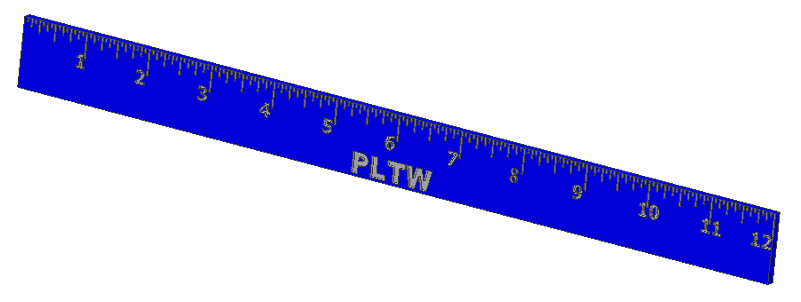

Measurement Systems
Two types of measurement systems exist.
  Standard (Customary)
Metric (SI or International System)
Notes:
Three countries have not officially adopted the International System of Units as their primary or sole system of measurement: Liberia, Myanmar, and the United States. The U. S. has switched to Metric with
Sporting Events - Olympics
Military
Medicine
Scientific studies
At this time, Manufacturing; Transportation; and Construction Industries; are primarily using the U.S. Customary system. In certain sectors, the conversion is obvious (i.e. – Automobiles). However, in these industry areas the changes have not been as complete.
This is the reasoning for studying both measurement systems used in the United States.

Slide 4
Standard (Customary) System
Inches
Fractions
The Whole Inch
2
First Half Second Half
¼ ¾
4
¹/₈ ³/₈ ⁵/₈ ⁷/₈
8
¹/₁₆ ³/₁₆ ⁵/₁₆ ⁷/₁₆ ⁹/₁₆ ¹¹/₁₆ ¹³/₁₆ ¹⁵/₁₆
16
Notes:
Notice that all denominators are even numbers. Therefore, if your numerator is also even, then your fraction can be reduced.

Slide 5
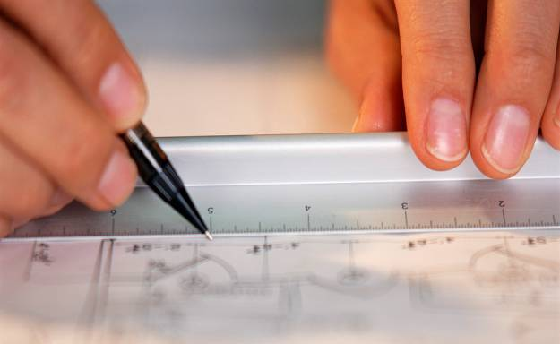
Steps in Using the
Standard (Customary) System
1. Find out how many parts the inches are divided into.
Count the spaces in 1 inch.
This number will be the denominator.
2. Count the number of whole inches.
Write down the number.
3. Count the number of spaces after the last whole inch.
This number will be the numerator.
4. Reduce fraction, if necessary.

Slide 6
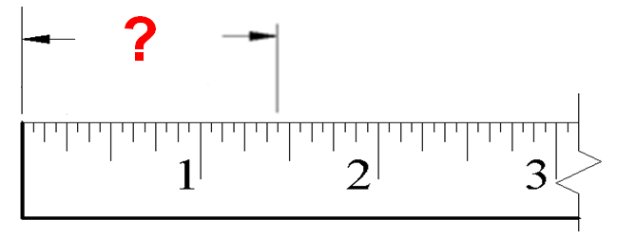
Let’s Review
7
Step 3
1
Find Numerator
Count Whole Inches
Step 2
16
Step 1
Find Denominator
Reduce Fraction, If Necessary
Step 4

Slide 7
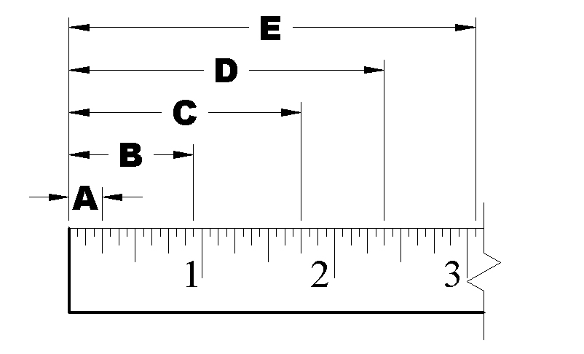
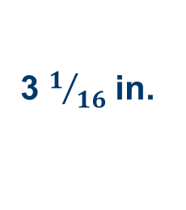
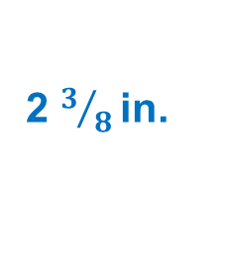
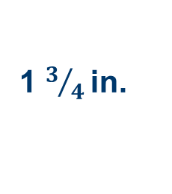
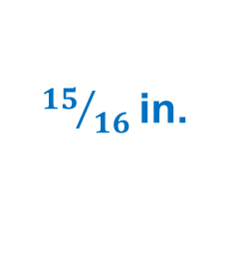
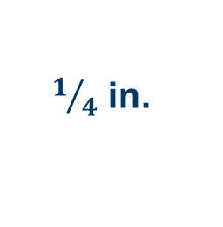
Let’s Practice
What is the distance from the end of the ruler to A?
$1/4$ in.
What is the distance from the end of the ruler to B?
${15}/{16}$in.
What is the distance from the end of the ruler to C?
1 $3/{4 }$in.
What is the distance from the end of the ruler to D?
2 $3/{8 }$in.
What is the distance from the end of the ruler to E?
3 $1/{16}$ in.

Slide 8
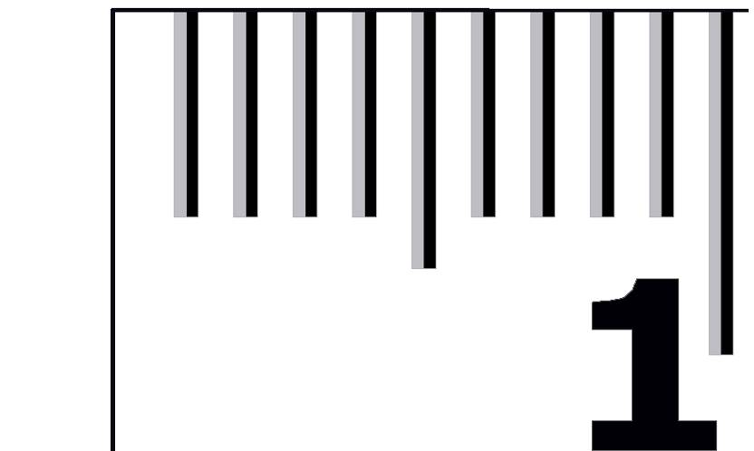
Metric System
International System of Units (SI)
Millimeters and
Centimeters
Decimals
1 mm = 0.1 cm
5 mm = 0.5 cm
10 mm = 1 cm
Notes:
The metric system is much easier to use than the English system because it was based on a decimal system (powers of ten). Therefore, you don't have to remember all the different conversions (16 ounces in a pound, 12 inches in a foot, and so on). You only have to remember a short list of prefixes that represent powers of ten. Common units for length, width, distance, thickness, girth, etc. are:
Millimeter mm 10⁻³ 10 mm = 1 cm
Centimeter cm 10⁻² 100 cm = 10 dm = 1 m
Decimeter dm 10⁻¹ 10 dm = 1 m
Kilometer km 10³ 1 km = 1000 m

Slide 9
Steps in Using the
Metric (SI) System
Count the number of whole centimeters (cm).
  These are the larger lines with numbers
2. Count the number of lines after the whole number.
  The smaller lines are millimeters (mm).
3. Put in correct terms.
  Since mm are 1/10th of a cm, if you measure 7 marks after 1 cm, the measure is 1.7 cm or 17 mm long.

Slide 10
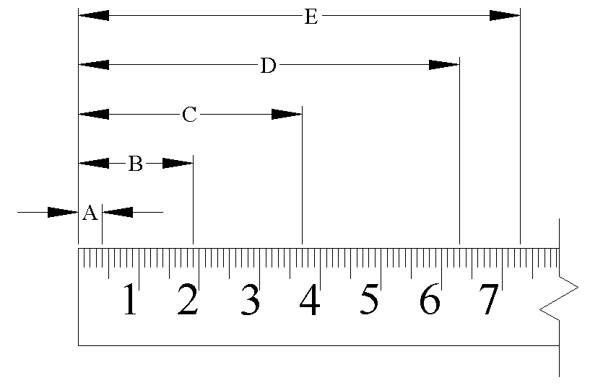
Let’s Practice
What is the distance from the end of the ruler to A?
4 mm = 0.4 cm
What is the distance from the end of the ruler to B?
19 mm = 1.9 cm
What is the distance from the end of the ruler to C?
37 mm = 3.7 cm
What is the distance from the end of the ruler to D?
63 mm = 6.3 cm
What is the distance from the end of the ruler to E?
73 mm = 7.3 cm

Slide 11
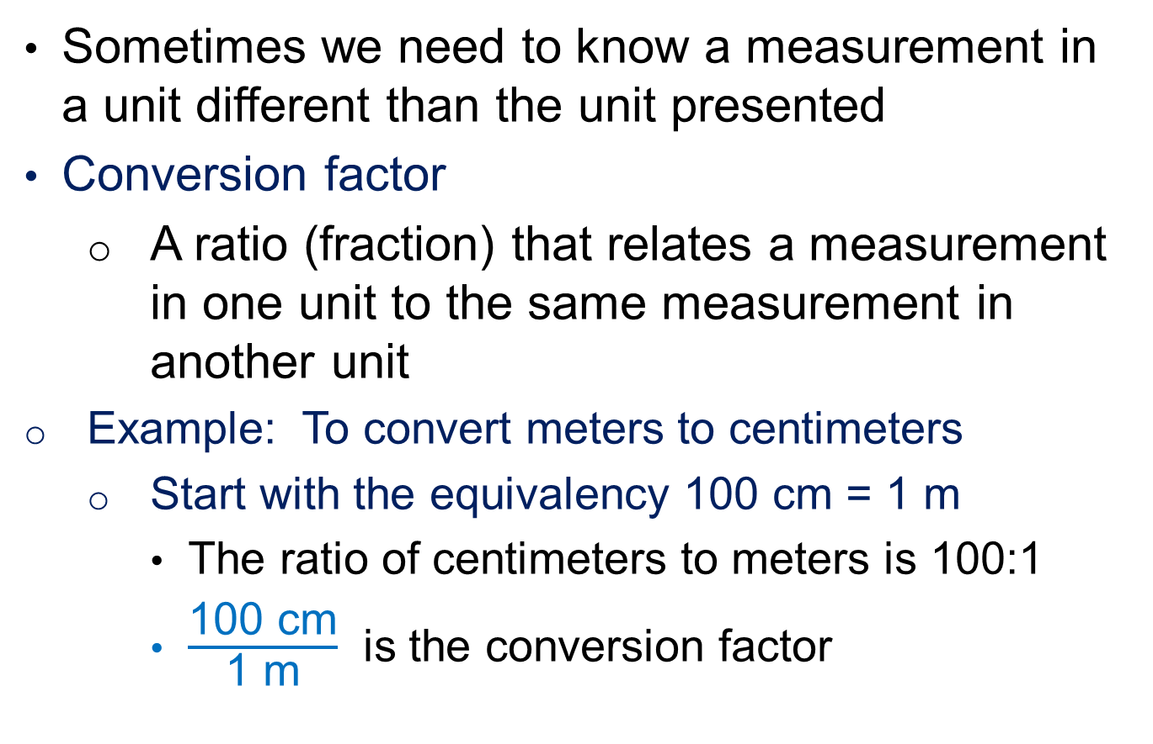
Unit Conversion
Sometimes we need to know a measurement in a unit different than the unit presented
Conversion factor
  A ratio (fraction) that relates a measurement in one unit to the same measurement in another unit
Example: To convert meters to centimeters
  Start with the equivalency 100 cm = 1 m
    $\text{The} \text{ratio} \text{of} \text{centimeters} \text{to} \text{meters} \text{is}\text{ 100:1}$
    $\frac{\text{100 }\text{cm}}{\text{1 }\text{m}}$ is the conversion factor

Slide 12


Unit Conversion
Desired Unit
or $\frac{\text{12 }\text{in}\text{.}}{\text{1 }\text{ft}}$
  feet to inches: 1 ft = 12 in.
    The ratio of inches to feet is 12:1
Given Unit
  miles to feet: 1 mi = 5280 ft or
    The ratio of feet to miles is 5280:1
$$\frac{\text{5280 }\text{ft}}{\text{1 }\text{mi} }$$
Notes:
Once you have identified the equivalency involving the given units and the desired units, create a ratio [click] with the desired units in the numerator and the given units in the denominator. [click]
What is the conversion factor used to convert miles to feet? [allow students to answer] [click]

Slide 13
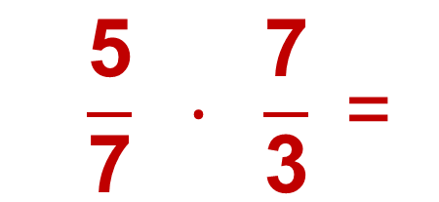
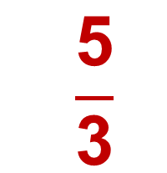
Unit Conversion
Conversion factor
  Using a conversion factor to cancel unwanted units is similar to canceling common factors when multiplying fractions
  $$\frac{\text{5}}{\text{7}} · \frac{\text{7}}{\text{3}} \text{=}$$
  $$\frac{\text{5}}{\text{3}}$$
Notes:
Canceling unwanted units using conversion factors is similar to canceling common factors when multiplying fractions. The numbers (or units) that are factors in both the numerator and the denominator can be canceled. [click]
For instance, in this problem, you may cancel the 7s – one in the numerator and one in the denominator – [click] to give a result of 5/3. [click]

Slide 14



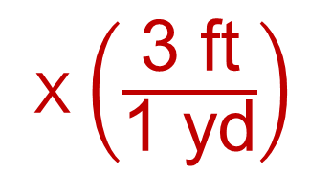
Unit Conversion
Example: Convert 17.2 yards to feet
$$\frac{\text{17.2 }\text{yd} }{\text{1}}$$
X $\left(\frac{\text{3 }\text{ft}}{\text{1 }\text{yd}}\right)$
= $\frac{\text{51.6 }\text{ft}}{\text{1}}$
$$=\text{51.6 }\text{ft}$$
3 ft = 1 yd
Notes:
[Click] Start with the original measurement. We will put it in the numerator over 1 to make it easier to see the fraction multiplication.
What is the appropriate conversion factor to convert yards to feet? [allow students to answer] [click]
The yards cancel [click] and you are left with 51.6 feet over 1. [click]
Or just 51.6 ft [click].

Slide 15
Unit Conversion
Example: Convert 17.2 yards to feet
$$\frac{\text{17.2 }\text{yd} }{\text{1}}$$
X $\left(\frac{\text{3 }\text{ft}}{\text{1 }\text{yd}}\right)$
= $\frac{\text{51.6 }\text{ft}}{\text{1}}$
$$=\text{51.6 }\text{ft}$$
3 ft = 1 yd
Notes:
[Click] Start with the original measurement. We will put it in the numerator over 1 to make it easier to see the fraction multiplication.
What is the appropriate conversion factor to convert yards to feet? [allow students to answer] [click]
The yards cancel [click] and you are left with 51.6 feet over 1. [click]
Or just 51.6 ft [click].

Slide 16




Unit Conversion
Your Turn: Convert 4 feet to inches
$$\frac{\text{4 }\text{ft}}{\text{1}}$$
X $\left(\frac{\text{12 }\text{in}\text{.}}{\text{1 }\text{ft}}\right)$
= $\frac{\text{48 }\text{in}\text{.}}{\text{1}}$
$$=\text{48 }\text{in}\text{.}$$
12 in. = 1 ft
Notes:
[Click] Start with the original measurement. We will put it in the numerator over 1 to make it easier to see the fraction multiplication.
What is the appropriate conversion factor to convert feet to inches? [allow students to answer] [click]
The feet cancel [click] and you are left with 48 inches over 1. [click]
Or just 48 inches [click].

Slide 17
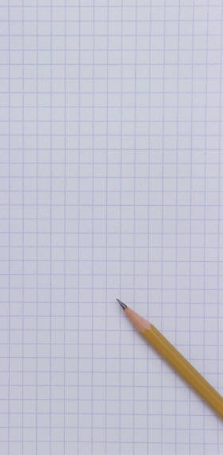
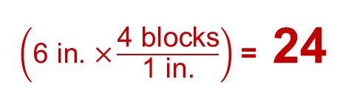
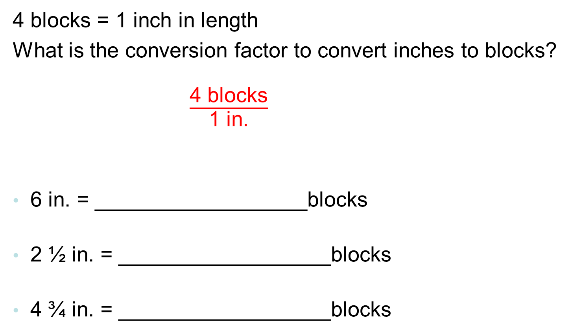
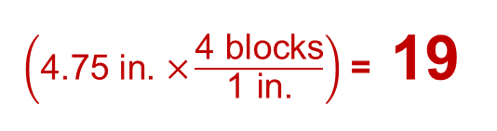
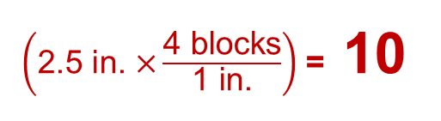
More Unit Conversions
Your Turn
4 blocks = 1 inch in length
What is the conversion factor to convert inches to blocks?
$\frac{\text{4 }\text{blocks}}{\text{1 }\text{in}\text{.}}$
6 in. = __________________blocks
2 ½ in. = __________________blocks
4 ¾ in. = __________________blocks
$\left(\text{6} \text{in}\text{. }\text{×}\frac{\text{4 }\text{blocks}}{\text{1} \text{in}\text{.}}\right)$ = 24
$\left(\text{2.5} \text{in}\text{. }\text{×}\frac{\text{4 }\text{blocks}}{\text{1} \text{in}\text{.}}\right)$ = 10
$\left(\text{4.75} \text{in}\text{. }\text{×}\frac{\text{4 }\text{blocks}}{\text{1} \text{in}\text{.}}\right)$ = 19

Slide 18
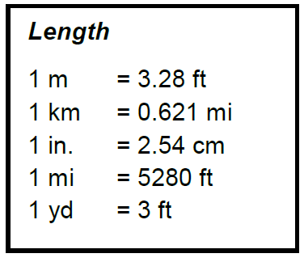
Common Conversions
The Gateway Formula Sheet provides many different length equivalencies.
We can use these to create conversion factors.

Slide 19

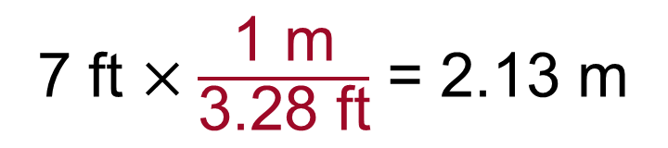
Common Conversions
What conversion factor would you use to convert 7 feet to a measurement in meters?
Desired Unit
$$\frac{\text{1 }\text{m}}{\text{3.28 }\text{ft}}$$
Given Unit
Convert 7 feet to meters
7 ft $×\frac{\text{1 }\text{m}}{\text{3.28 }\text{ft}}$ = 2.13 m

Slide 20

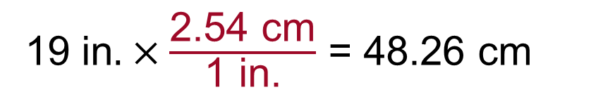
Common Conversions
What conversion factor would you use to convert 19 inches to a measurement in centimeters?
Desired Unit
$$\frac{\text{2.54 }\text{cm}}{\text{1 }\text{in}\text{.}}$$
Given Unit
Convert 19 in. to cm
1$\text{9 }\text{in}. ×\frac{\text{2.54 }\text{cm}}{\text{1 }\text{in}\text{.}}$ = 48.26 cm

Slide 21
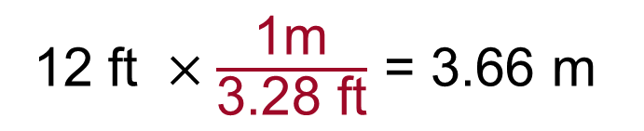
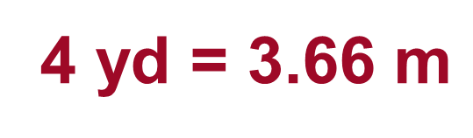
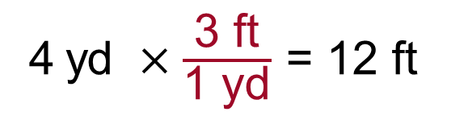
Common Conversions
What conversion factor would you use to convert 4 yards to a measurement in meters?
First, convert yards to feet
4$\text{yd} ×\frac{\text{3 }\text{ft}}{\text{1 }\text{yd}}$ = 12 ft
Next, convert feet to meters
1$\text{2 }\text{ft} ×\frac{\text{1}\text{m}}{\text{3.28 }\text{ft}}$ = 3.66 m
4$\text{yd}\text{ = 3.66 }\text{m}$

Slide 22
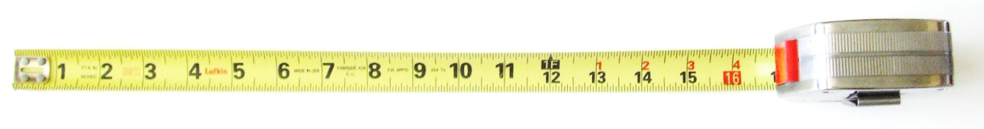
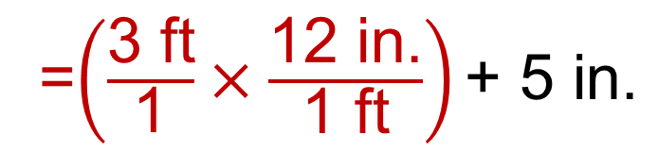

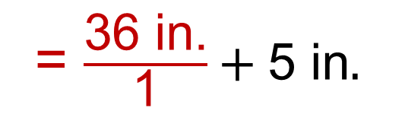
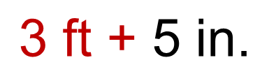
Unit Conversion
Example: Convert 3′-5″ to inches
12 in. = 1 ft
=$\left(\frac{\text{3} \text{ft}}{\text{1}}×\frac{\text{12 }\text{in}\text{.}}{\text{1 }\text{ft}}\right)\text{+ 5 }\text{in}\text{.}$
$$\text{3} \text{ft}\text{ + 5 }\text{in}\text{.}$$
= $\frac{\text{36} \text{in}\text{.}}{\text{1}}+\text{5 }\text{in}.$
$$=\text{41} \text{in}\text{.}$$
Notes:
[Click] Start with the original measurement. Since 5 inches is already in the correct units, we only need to convert the 2 feet to inches [click].
We use the same conversion factor that we used in the last example to convert feet to inches [click].
The feet cancel [click] and you are left with 24 inches over 1.
Add the original 5 inches.
24 inches + 5 inches equals 29 inches [click].

Slide 23
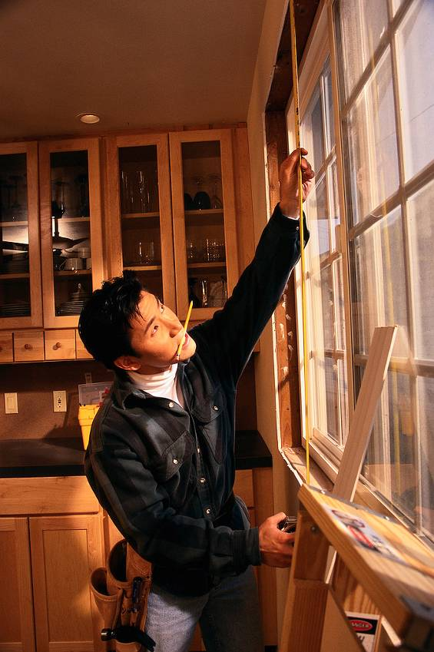
Let’s Practice
You used a meter stick to measure your window for new shades. However, the shade packages list the measurements in English units. Luckily your cell phone has a calculator so that you can quickly convert your 81.3 cm by 91.4 cm window opening to English units. What size is your window using English units? Round to the nearest inch.

Slide 24
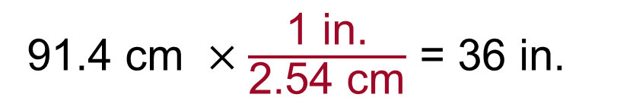
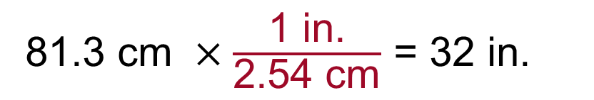
Let’s Practice
Convert 81.3 cm x 91.4 cm to English units. Round to the nearest inch.
8$\text{1.3 }\text{cm} ×\frac{\text{1 }\text{in}\text{.}}{\text{2.54 }\text{cm}}$ = 32 in.
9$\text{1.4 }\text{cm} ×\frac{\text{1 }\text{in}\text{.}}{\text{2.54 }\text{cm}}$ = 36 in.
Therefore, the window opening is 32 in. x 36 in.

Slide 25
Image Resources
Microsoft, Inc. (2008). Clip Art. Retrieved October 7, 2008, from http://office.microsoft.com/en-us/clipart/default.aspx

