Slide 1
3D Computer Modeling
Using Inventor™
Design and Modeling

Slide 2
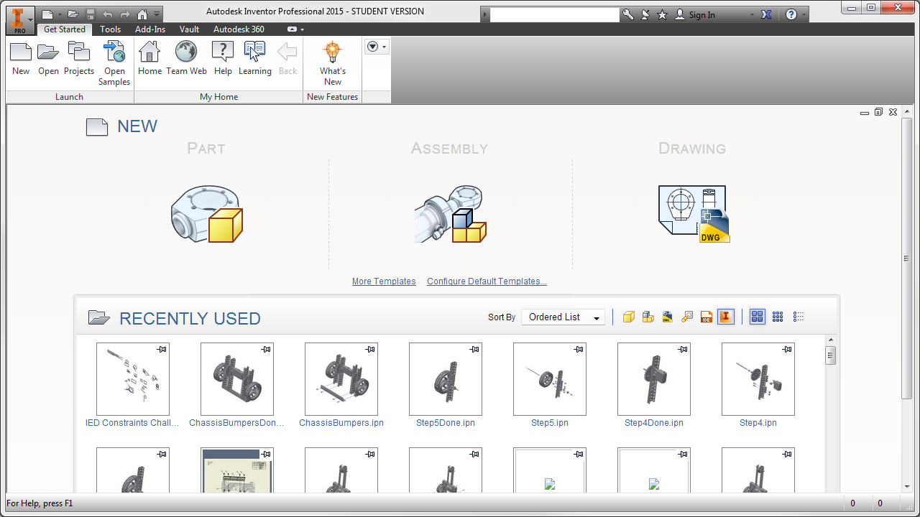
Getting Started with Inventor
When you first open Inventor, you have the option to begin a new part, assembly, or drawing. Recently used items are available to open below. You can also open or start new files using the ribbon at the top of the window. When starting a new file, be sure to configure the template for the correct system, either English or Metric.
Notes:
.idw stands for Inventor drawing file
.iam stands for Inventor assembly file
.ipt stands for Inventor part file
.ipn stands for Inventor presentation file

Slide 3
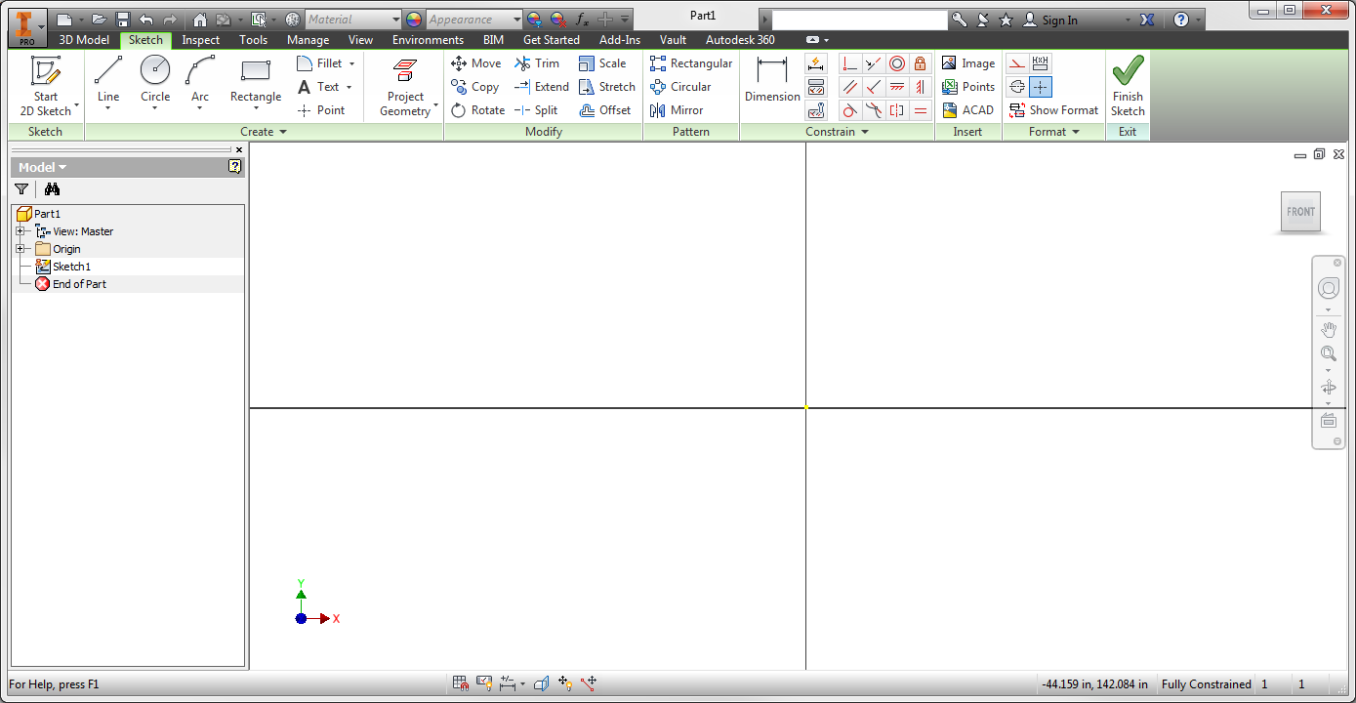
Inventor Screen Layout
Quick Access Toolbar
Application Menu
  Contains common commands for creating, saving, and printing.
Quick Access Toolbar
  Provides quick access to frequently used commands
Ribbon
  A palette that displays buttons and controls used for both 2D drawing and annotation and 3D modeling and viewing
Graphics Window
  The active modeling area where parts and assemblies are created and edited
Application Menu
Ribbon
Graphics
Window
Notes:
Show students how to use the help command to find answers to their questions.

Slide 4
Inventor Screen Layout
Ribbon Tabs
  Organized by task, contain task specific buttons and controls
Panel
  Categorized tasks with quick access to commonly used tasks and an expandable menu for additional related options
Ribbon Tabs
Panel

Slide 5
Inventor Screen Layout
View Cube
  Clickable and draggable interface that is used to switch between standard and isometric views
Navigation Bar
  On screen element that provides access to various navigation tools
Browser
  Maintains history of part, assembly, or drawing creation
  3D Indicator
  Shows direction of X, Y, and Z coordinates.
  Red represents X,
  Green represents Y
  Blue represents Z directions
View
Cube
Browser
3D Indicator
Navigation Bar

Slide 6
Mouse Buttons
Left Mouse Button
  Used to select icons, menus, and graphics
Right Mouse Button
  Brings up additional options
  Accepts default option
  Ends a process
Middle Button/Wheel
  Provides quick pan and zoom functions
Middle Wheel/Button
Left Button
Right Button
Notes:
Demonstrate that ESC on the keyboard cancels a command.

Slide 7
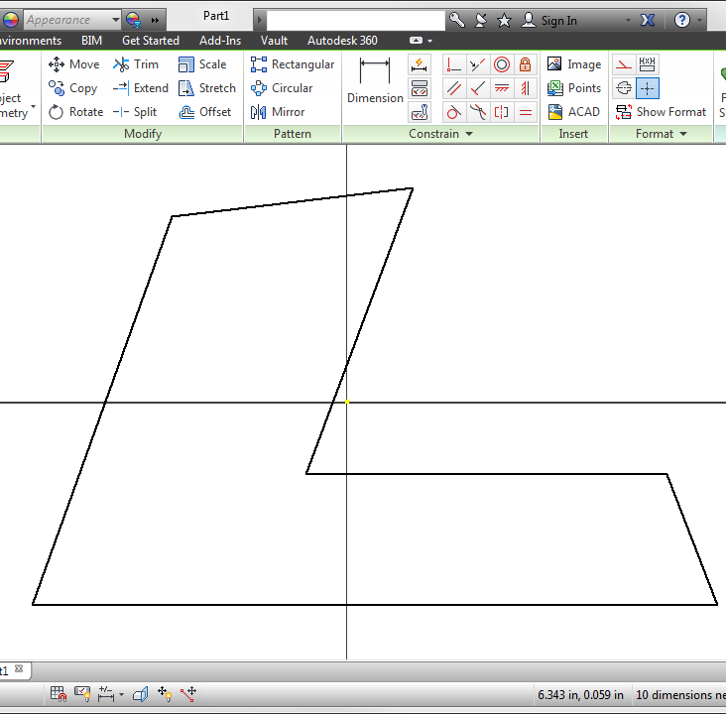
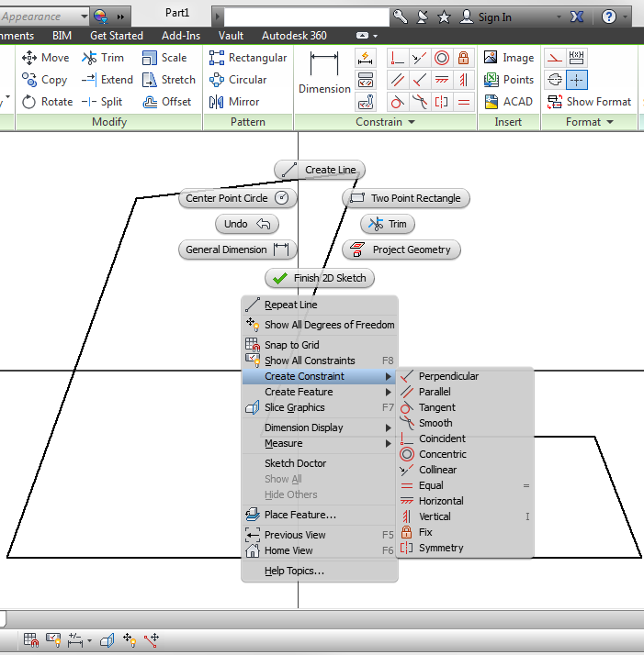
Geometric Constraints
Symbols that show alignments to capture the design intent
To use Geometric Constraints:
1. Use the commands available from the Constrain panel
2. Right mouse click in Graphics Window, then select Create Constraint
OR
Notes:
Students should experience sketching in the 3D Modeling software before you discuss this slide. Ask whether they noticed symbols that appeared as they sketched. These clues or symbols show alignments or constraints that the software assumes you want.

Slide 8
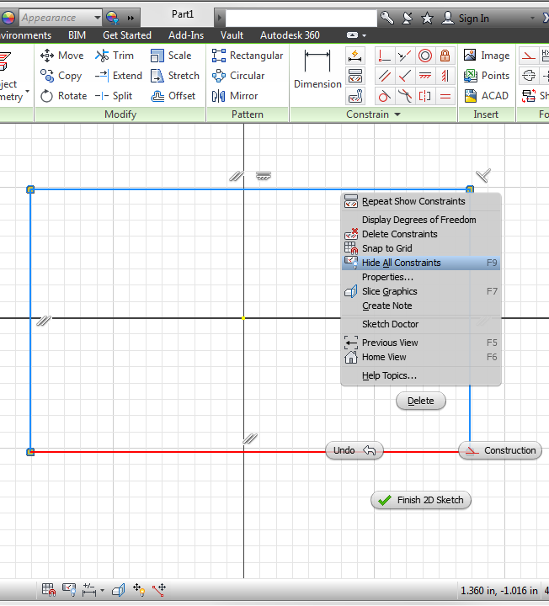
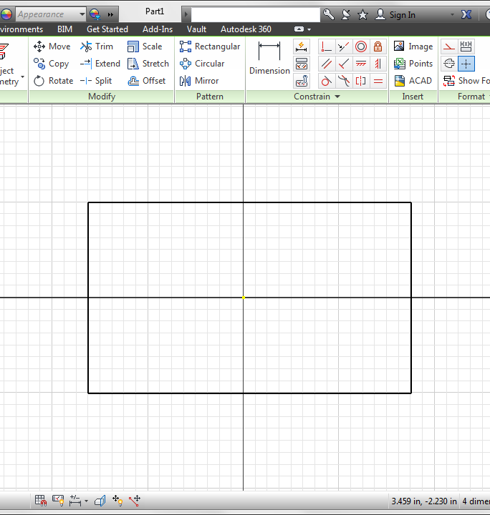
Show and Hide Constraints
Constraints can be shown or hidden using the Show Constraints button in the Constrain panel, using the menu by right clicking in Graphics Window, or the F9 key

Slide 9




Geometric Constraint Symbols
 | Perpendicular | Lines are at right angles
 | Parallel | Line is parallel to other objects
 | Tangent | Touches at one point only
 | Smooth | Create a continuous curve
 | Coincident | Constrains 2 points or point to curve
 | Concentric | Arc or Circle shares center point
 | Collinear | 2 lines lie along the same line
 | Equal | Resizes to same radius or length
 | Horizontal | Line is parallel to X axis
 | Vertical | Line is parallel to Y axis
 | Fix | Points or curves stay locked in place
 | Symmetry | Objects align symmetrically about a line

Slide 10

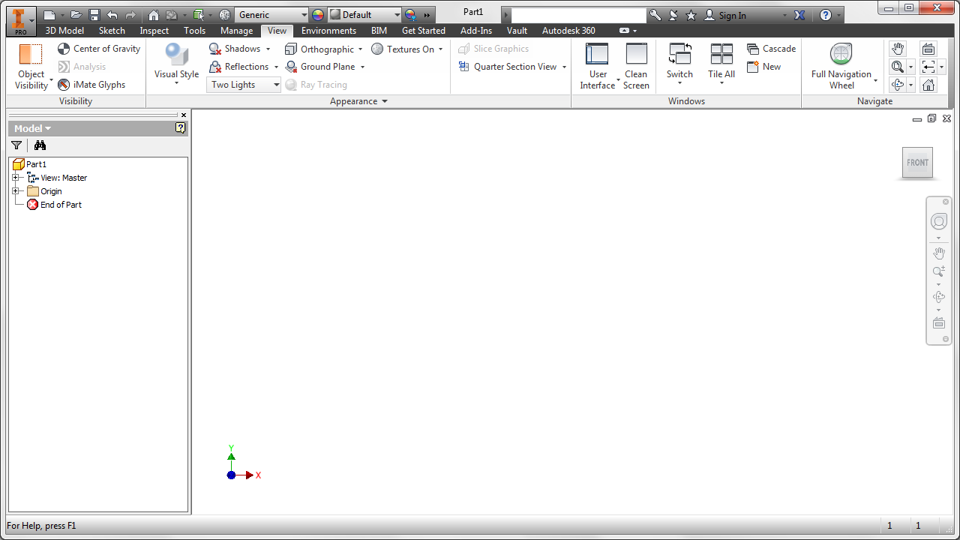
Dynamic Viewing Functions
Located on View Ribbon Tab
Used to Zoom and Pan to reposition the sketch
 | Pan
 | Zoom
 | Zoom Window
 | Zoom All
 | Zoom Selected
 | Dynamic Rotation
 | Look At
Notes:
The teacher will demonstrate and students should practice using all of the dynamic viewing functions.

Slide 11
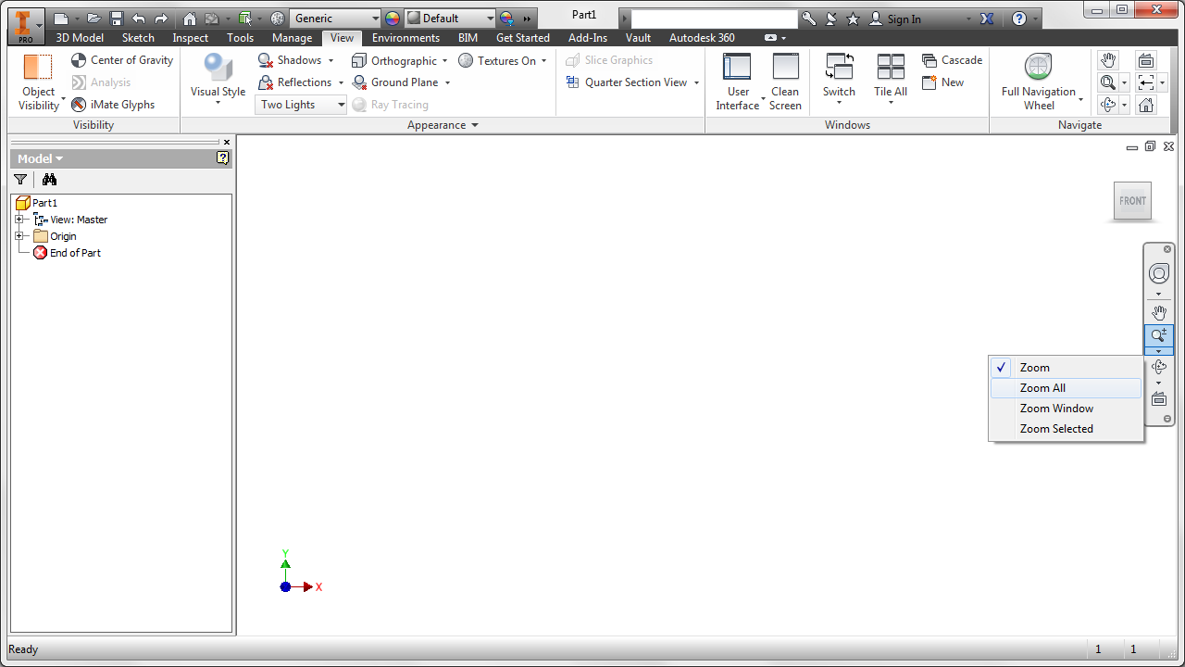
Dynamic Viewing Functions
Zoom All, under the Zoom button menu and on the Navigate panel, zooms as necessary to show all created geometry in the graphic window
Notes:
The teacher will demonstrate and students should practice using all of the dynamic viewing functions.

Slide 12
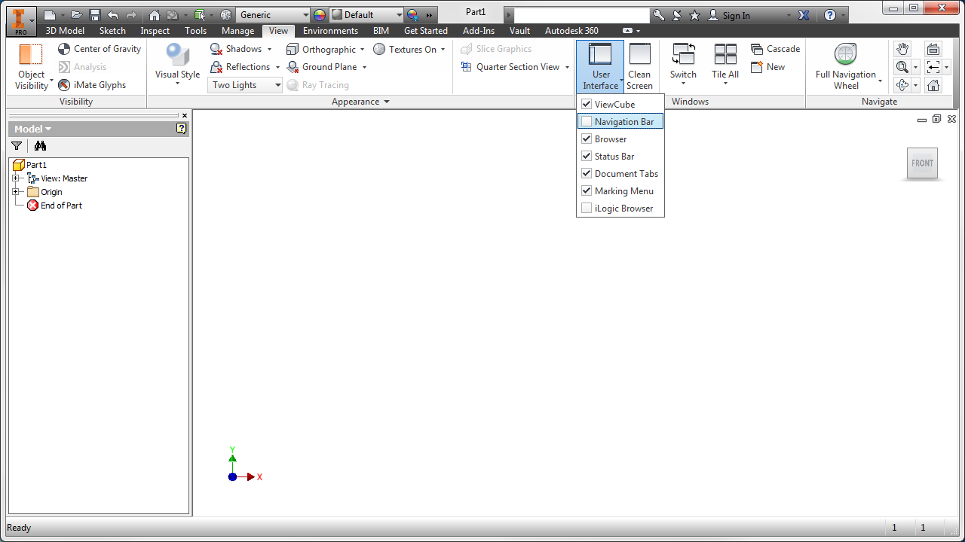
Recover Missing Menus
Turn on or off various interface features with the User Interface drop down menu under the View tab
Notes:
The teacher should discuss the situation that often occurs when student “lose” the browser or navigation bar. Demonstrate how the UI components can be turned on again.

Slide 13
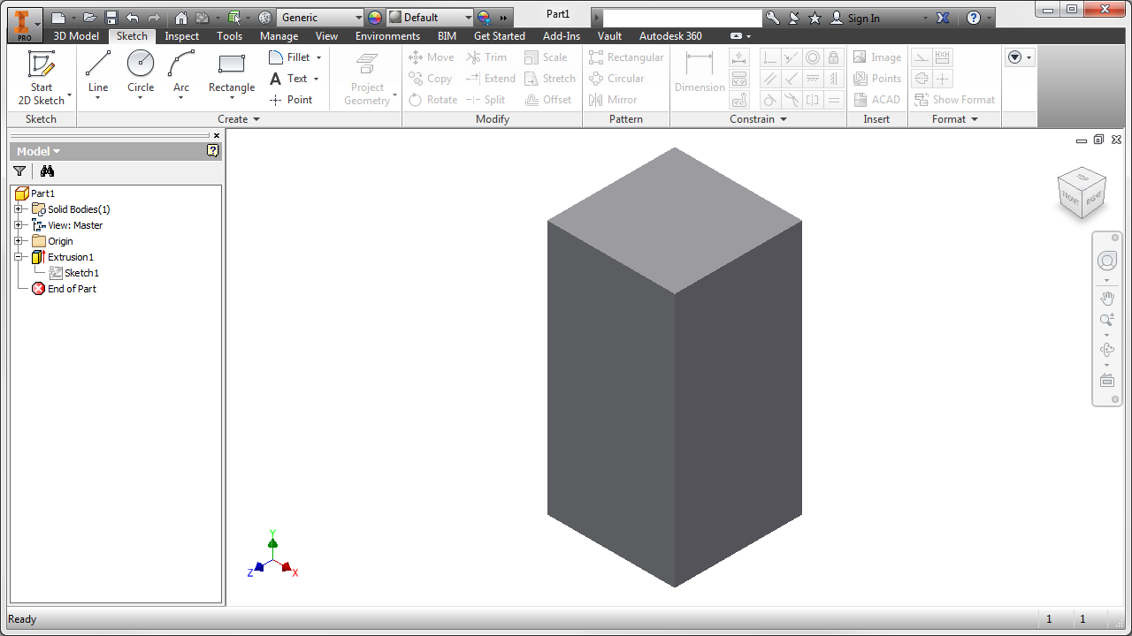
Expand Browser Steps
Click the plus icon to expand each feature and edit a sketch or constraint.
Notes:
A sketch that is integral to a feature will be “consumed” by that feature. You can expand a feature in the browser, such as this extrusion, to display the sketches that were used (or consumed) during the creation of the feature.

Slide 14
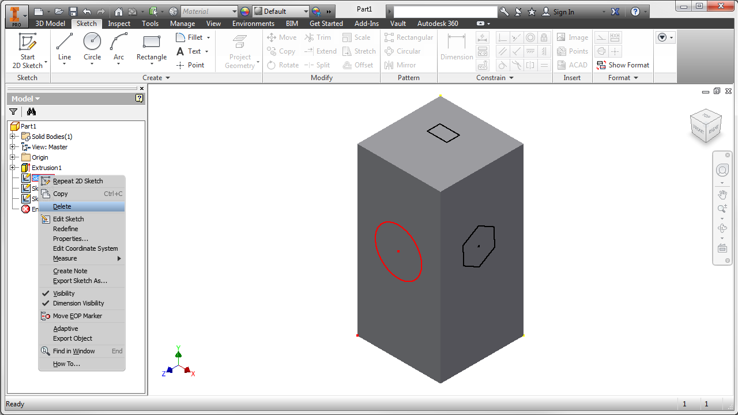
Remove Unused Sketches
Delete extra or unassociated sketches and objects from the browser.
Right click the sketch and select Delete.
Notes:
In the browser, consumed sketches are contained within the feature “folder” and can be seen if the feature is expanded. If a sketch is unconsumed, that is, a sketch is not integral to a feature and is not contained in a feature “folder”, it is likely that the sketch is unnecessary and should be deleted.

Slide 15
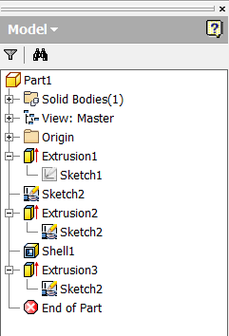
Shared Sketches
Shared sketch
Consumed in multiple features
Notes:
Note that if a sketch is shared, such that the sketch is used in the creation of more than one feature, the sketch will appear as a separate component in the browser, but the icon associated with the sketch will include a small hand. The icon for a sketch that is not shared will not contain a hand. Can you find the unshared sketch in the browser above?
SHARED sketches should not be deleted.

Slide 16
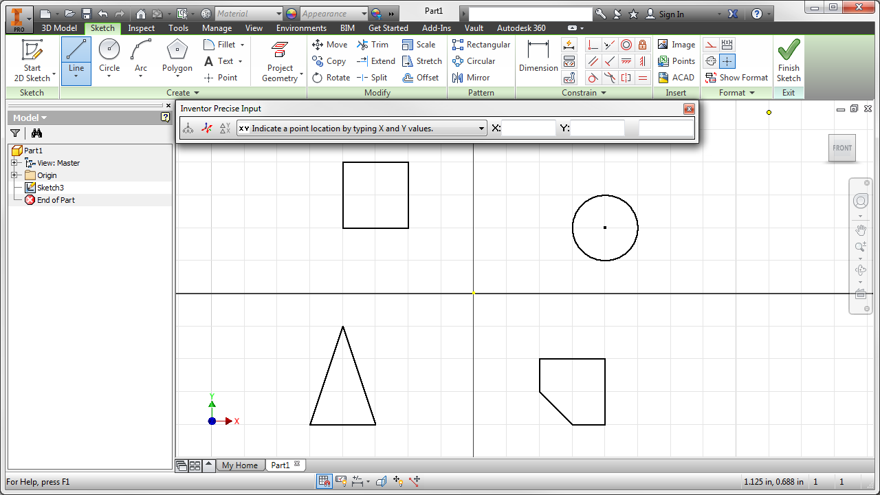
Precise Input
The Precise Input toolbar is added by expanding the Create panel and selecting Precise Input
Create the shapes that you labeled in Activity 1.5.1 The Coordinate System and Descriptive Geometry.
Notes:
Precise Input
Precise input is a method used to plot coordinates. Precise input allows the user to specify precise coordinates when creating a sketch. You can enter coordinates to specify the location for a point.

Slide 17
Image Resources
Microsoft, Inc. (2008). Clip Art. Retrieved November 4, 2008, from http://office.microsoft.com/en-us/clipart/default.aspx

