Slide 1
Basic Assembly Constraints
Design and Modeling

Slide 2
Basic Assembly Constraints
Define how parts relate to each other
Restrict the movement between parts
6 Degrees of Freedom
3 Rotational around X, Y, Z axes
3 Translational around X, Y, Z axes

Slide 3
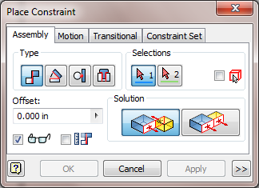
Basic Assembly Constraints
4 Basic Constraints
Mate Angle Tangent Insert

Slide 4
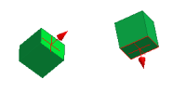
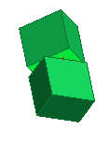
Basic Assembly Constraints
Mate
Constrains 2 faces, edges, points, or work features together

Slide 5
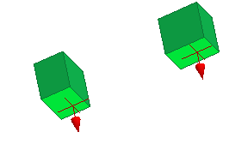
Basic Assembly Constraints
Flush
Constrains 2 faces, edges, points, or work features together
Geometry side-by-side

Slide 6
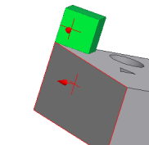
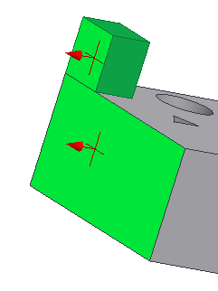
Basic Assembly Constraints
45° angle
Angle
Constrains 2 faces or edges at an angle to one another
0° angle

Slide 7
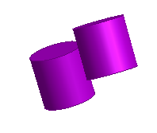
Basic Assembly Constraints
Tangent
Constrains a curved surface to a plane or another curved surface

Slide 8
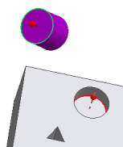
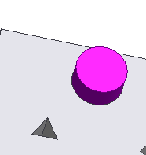
Basic Assembly Constraints
Insert
Constrains a cylinder flush into a hole

Slide 9
Browser Editing Assembly Constraints
Expanding a part file in the browser will show the applied constraints
To edit, slowly hover mouse over the constraint to identify it
Right click and select delete to remove a constraint

