Slide 1
Chapter M5
Section 1 What Is Energy?
Energy and Work: Working Together
Energy is the ability to do work.
Work is done when a force causes an object to move in the direction of the force. Work is a transfer of energy.
Energy and work are expressed in units of joules (J).

Slide 2
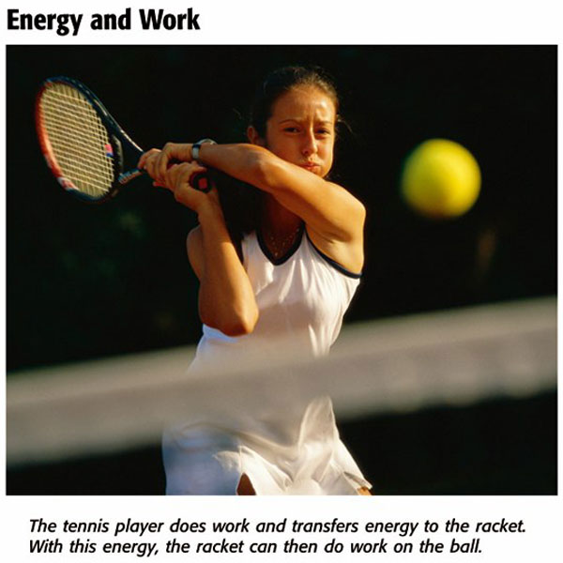
Chapter M5
Section 1 What Is Energy?

Slide 3
Chapter M5
Section 1 What Is Energy?
Kinetic Energy
Kinetic energy is the energy of motion. All moving objects have kinetic energy.
If you know an object’s mass (m) and its speed (v), you can calculate the object’s kinetic energy with the following equation:
m
v
2
k
i
n
e
t
i
c
e
n
e
r
g
y
=
2

Slide 4
Chapter M5
Section 1 What Is Energy?
Kinetic Energy
Click below to watch the Visual Concept.
You may stop the video at any time by pressing the Esc key.
Visual Concept

Slide 5
Chapter M5
Section 1 What Is Energy?

Slide 6
Chapter M5
Section 1 What Is Energy?
Potential Energy
Potential energy is the energy an object has because of its position.
Gravitational Potential Energy The amount of gravitational potential energy that an object has depends on its weight and its height.

Slide 7
Chapter M5
Section 1 What Is Energy?
Potential Energy, continued
The equation to find gravitational potential energy is:
gravitational potential energy = weight × height
Gravitational potential energy is equal to the amount of work done on an object to lift it a certain height.

Slide 8
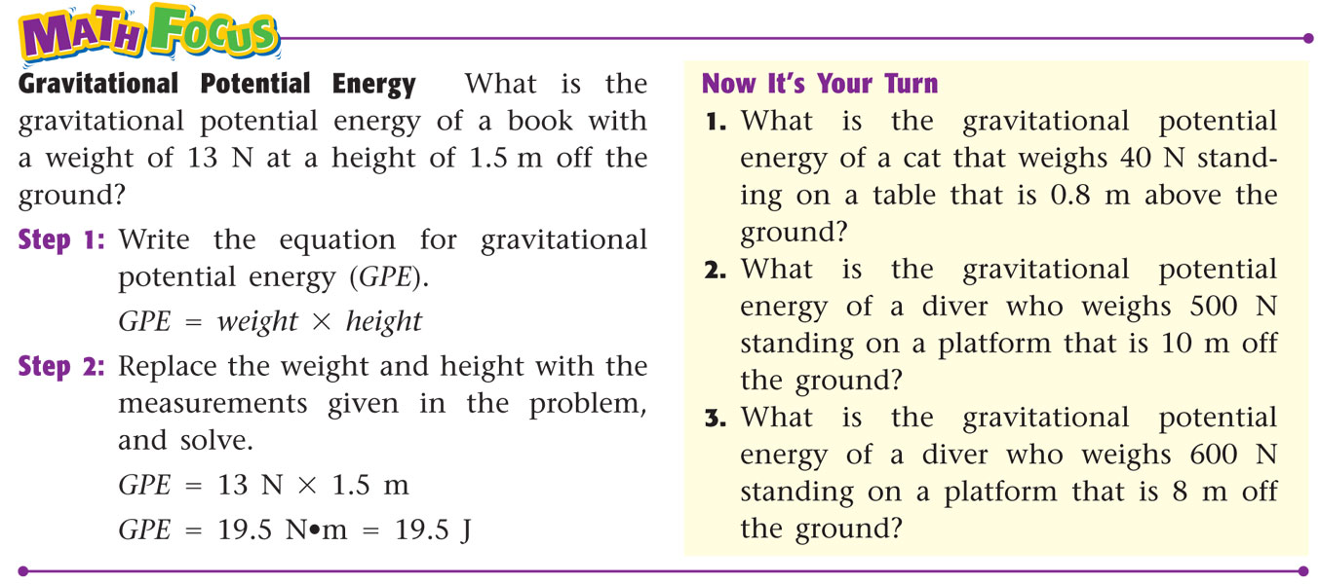
Chapter M5
Section 1 What Is Energy?

Slide 9
Chapter M5
Section 1 What Is Energy?
Potential Energy, continued
Height Above What? When you find out an object’s gravitational potential energy, the “ground” that you measure the object’s height from depends on where it is.
The height you use in calculating gravitational potential energy is a measure of how far an object has to fall.

Slide 10
Chapter M5
Section 1 What Is Energy?
Mechanical Energy
Mechanical energy is the total energy of motion and position of an object. Both kinetic energy and potential energy are kinds of mechanical energy.
The equation to find mechanical energy is:
mechanical energy = potential energy + kinetic energy

Slide 11
Chapter M5
Section 1 What Is Energy?
Mechanical Energy, continued
The mechanical energy of an object remains the same unless it transfers some energy to another object.
But even if the mechanical energy of an object stays the same, the potential energy or kinetic energy can increase or decrease.

Slide 12
Chapter M5
Section 1 What Is Energy?
Other Forms of Energy
Thermal Energy is all of the kinetic energy due to random motion of the particles that make up an object.
All matter is made up of particles that are always in random motion. So, all matter has thermal energy.
Thermal energy increases as temperature increases and increases as the number of particles increases.

Slide 13
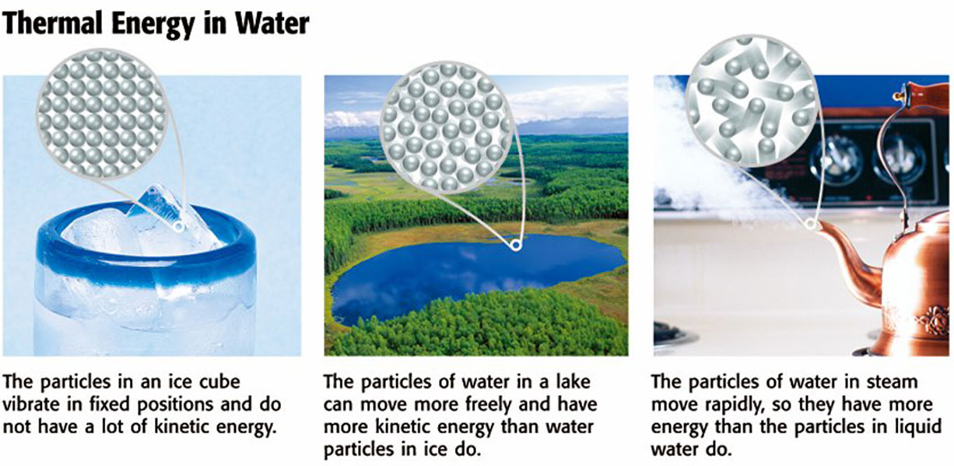
Chapter M5
Section 1 What Is Energy?

Slide 14
Chapter M5
Section 1 What Is Energy?
Other Forms of Energy, continued
Chemical Energy is the energy of a chemical compound that changes as its atoms are rearranged.
Chemical energy is a form of potential energy because it depends on the position and arrangement of the atoms in a compound.
The energy in food is chemical energy.

Slide 15
Chapter M5
Section 1 What Is Energy?
Other Forms of Energy, continued
Electrical Energy is the energy of moving electrons. Electrical energy can be thought of as potential energy that is used when you plug in an electrical appliance and use it.
Sound Energy is caused by an object’s vibrations. The object’s vibrations transmit some kinetic energy to the air particles, which also vibrate. These vibrations transmit sound energy.

Slide 16
Chapter M5
Section 1 What Is Energy?
Other Forms of Energy, continued
Light Energy is produced by the vibrations of electrically charged particles.
Nuclear Energy is energy that comes from changes in the nucleus of an atom. Nuclear energy can be produced when nuclei are joined in a fusion reaction or when a nucleus is split apart in a fission reaction.

